Slide 1
Video Analytics: Human Action Recognition (HAR)
Team Members:
Unnath Chittimalla, Velidanda Krishna Sai

Slide 2
Why HAR?
Importance of HAR (Human Action Recognition)
Applications in Real World:
Smart surveillance (detecting suspicious activity)
Healthcare (monitoring elderly movements)
Sports analytics (tracking athlete performance)
Human-computer interaction (gesture-based controls)
AR/VR (gesture-based interactions)
Challenges in HAR
Variability in Actions (e.g., different styles of walking or jumping)
Occlusions & Camera Angles (Partial visibility can affect accuracy)
Multi-Person Tracking Issues (Handling overlapping people)
Computational Complexity (Real-time processing on edge devices)

Slide 3
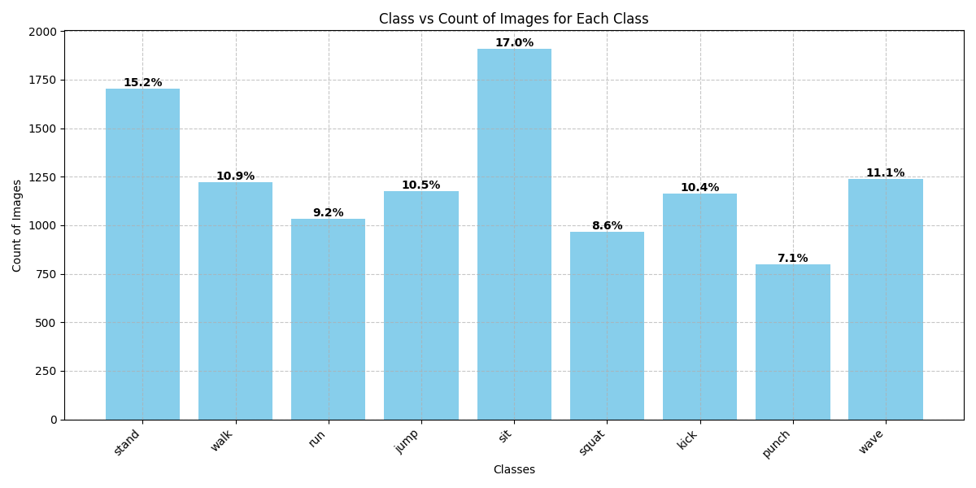
Current Dataset
Class-Wise Data Analysis
Training/Testing Split: 70 train / 30 test
~11k Total Images
We used stratified approach while early stop training to ensure validation of all classes equally

Slide 4
Methodology: PoseNet + Tracking + MLP
We use a modular approach that extends from a single person pose and action recognition method.
Workflow diagram explaining the following.
Role of OpenPose (MobileNet-CMU)
Detect persons using a person detector CNN like Faster-RCNN/YOLO.
Perform Pose Estimation and extract the 18 skeleton keypoints.
Get vector of shape (1, 36) where even index is x-position, odd index is y-position.
Processing and Feature Extraction
Perform Pose Estimation and extract the 18 skeleton keypoints.
Get tensor of shape (1, 36) where even index is x-position, odd index is y-position. Then use tracking to distinguish different people, store person id, video idx, frame idx, label, path to image so now we have tensor of shape (1, 36+5)
Filter out good skeletons, normalize joints position, calculate body and joint velocities using window of 5 frames. Also add noise if needed. Feature Vector shape is (1, 314 because 5*26(position) + 26*4(differences) + 2*4(neck velocity*10 times repeat) )
MLP Layer (3 Hidden Layers with 20, 30, 40 nodes in respective layer)
PCA (Principal Component Analysis) is used to reduce the features from (samples, 314) to (samples, 50)
This is fed into the MLP and output nodes are equal in number to required classes.
Early stopping is used to automatically stop training when loss/accuracy converges.

Slide 5
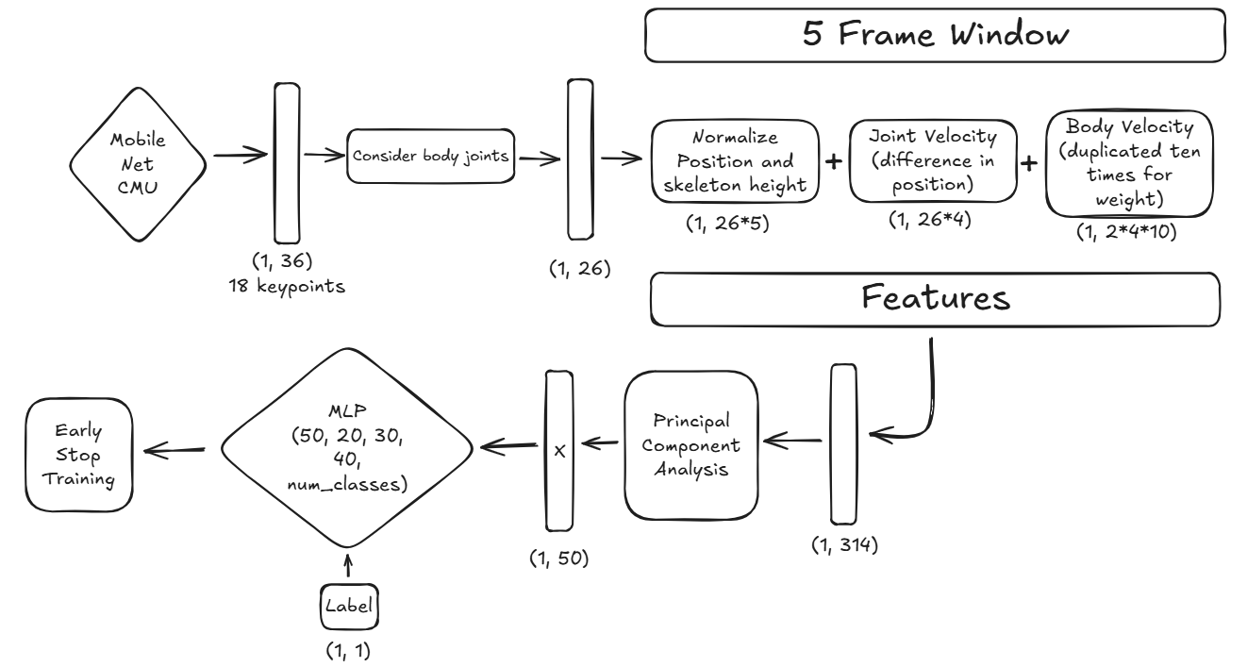
Feature Extraction and MLP

Slide 6
Feature Extraction and MLP

Slide 7
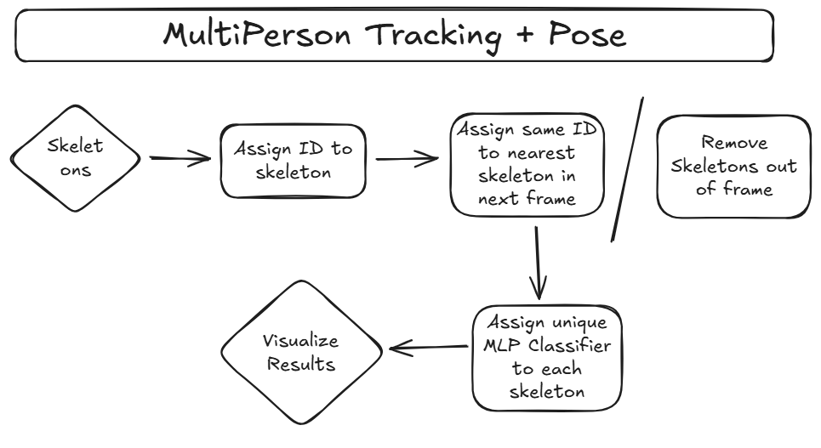
MultiPerson Tracking

Slide 8
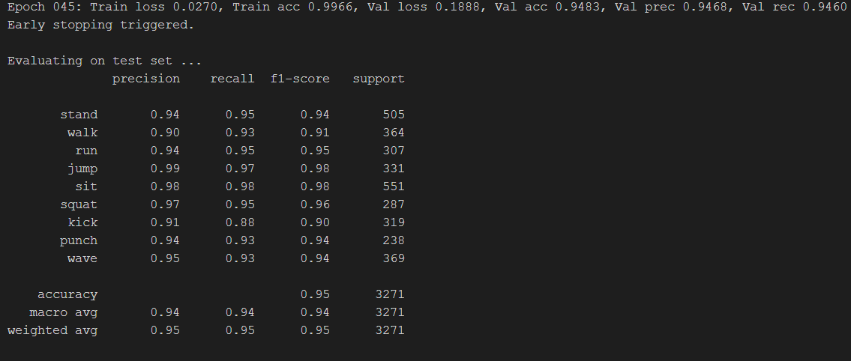
Results - Summarized

Slide 9
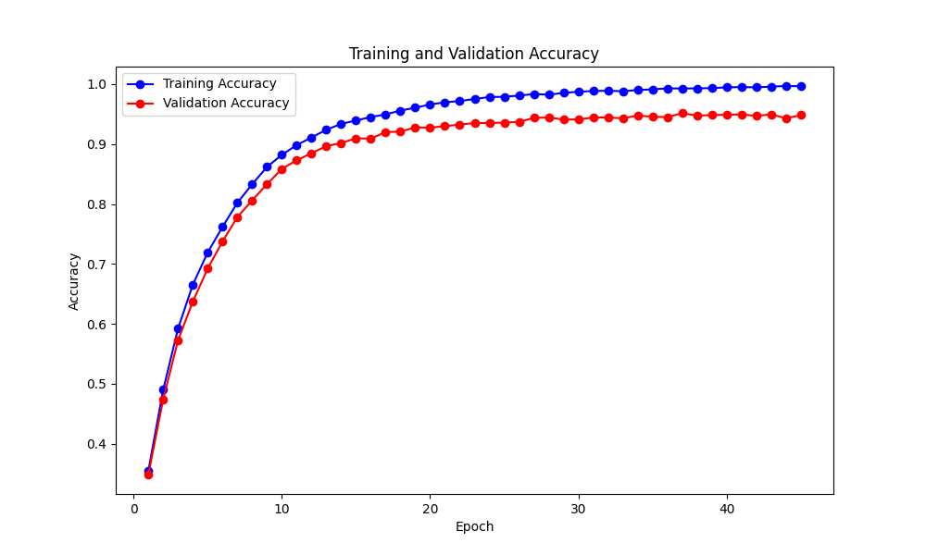
Results – Training/Validation Accuracy

Slide 10
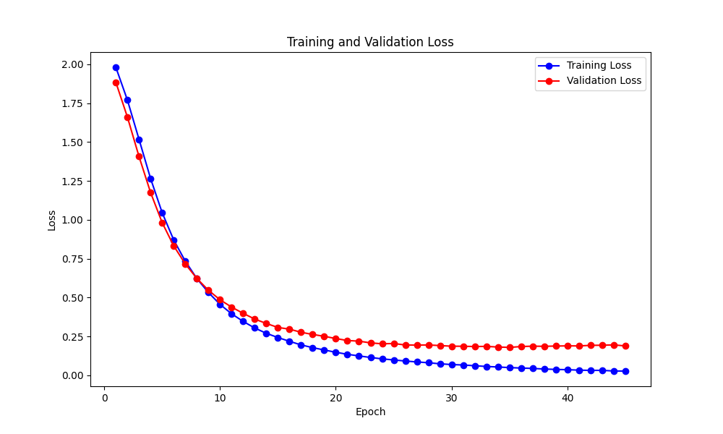
Results – Training/Validation Loss

Slide 11
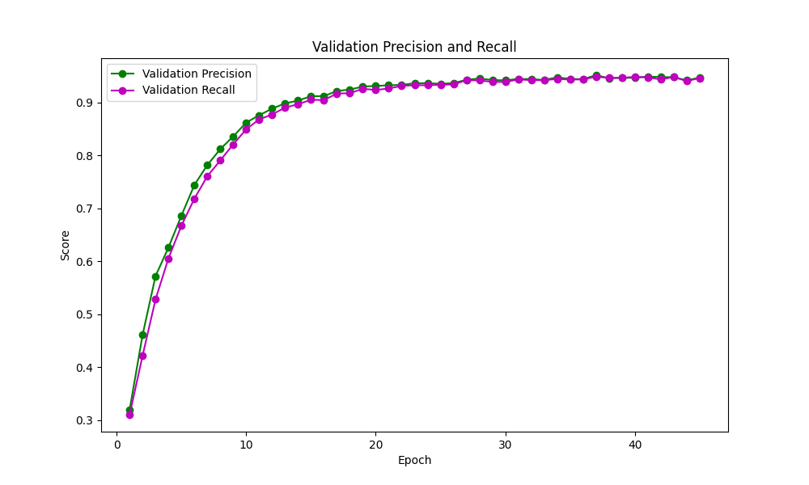
Results – Precision/Recall

Slide 12
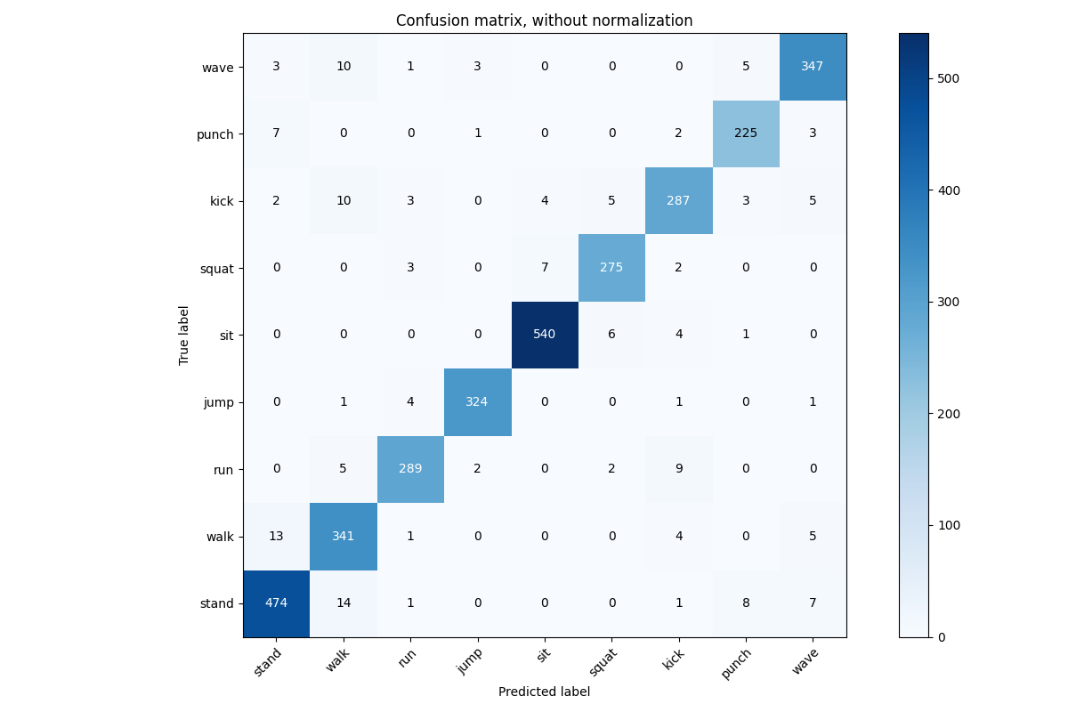
Results – Confusion Matrix

Slide 13
Methodology: ViViT on Kinetics400
We build upon google’s model on huggingface meant for the kinetics400 dataset.
Workflow diagram explaining the following.

